Slide 1



SECURE DATA HIDING IN IMAGES USING STEGANOGRAPHY
Presented By:
Student Name : KALLE MEGHANA
College NAME : NRI INSTITUTE OF TECHNOLOGY
Department : CSE

Slide 2
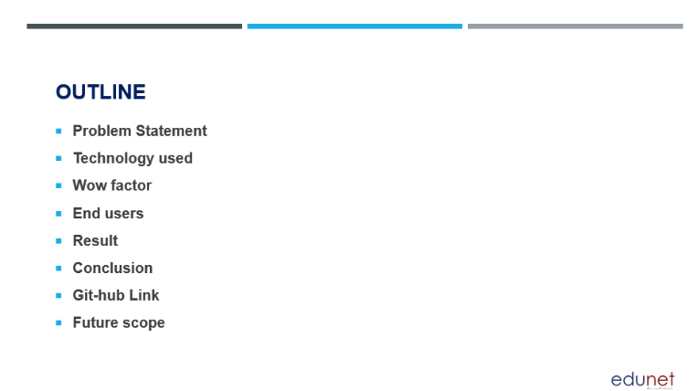

Slide 3
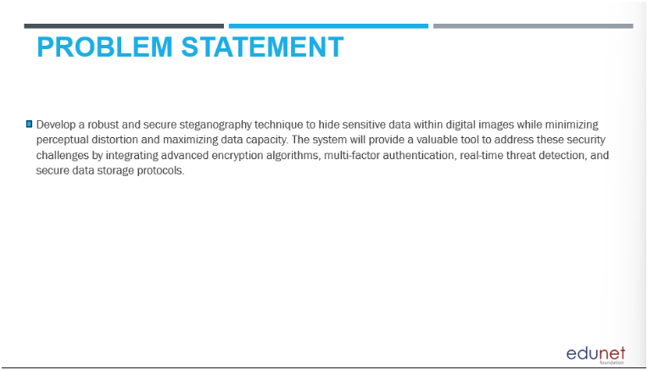
.
Develop a robust and secure steganography technique to hide sensitive data with in digital images while minimizing perceptual distortion and maximizing data capacity.
The system will provide a valuable tool to adderss these security challenges by integrating advanced encryption algorithm, multifactor authentications, real time threat detection and secure data storage protocols.
.

Slide 4
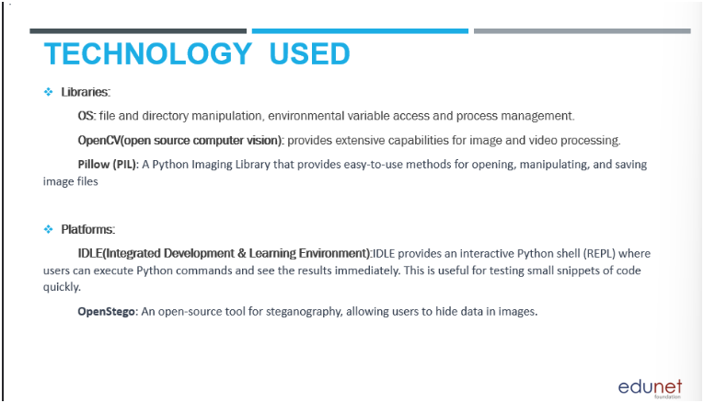
.
Libraries:
OS: Manages file and directory operations.
OpenCV: Offers advanced image and video processing capabilities.
Pillow (PIL): Simplifies image file handling in Python.
Platforms:
IDLE: An interactive Python environment for executing commands.
OpenStego: Enables steganography to hide data in images.
.
.
.
.

Slide 5
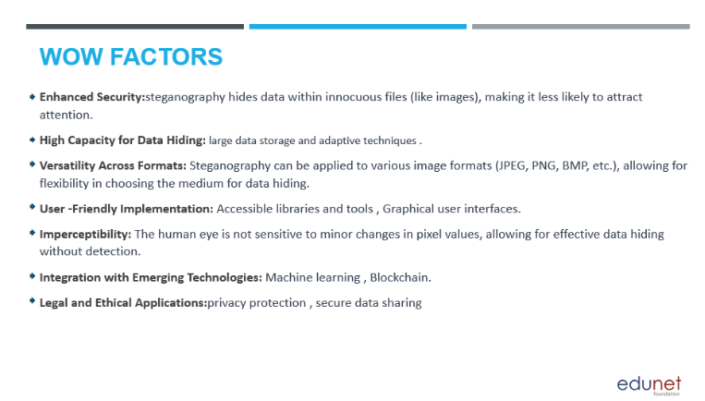
.
Enhanced Security: Steganography conceals data within innocuous files, reducing detection risk.
High Capacity for Data Hiding: Supports large data storage and adaptive techniques.
Versatility Across Formats: Applicable to various image formats (JPEG, PNG, BMP), offering flexible data hiding options.
User-Friendly Implementation: Features accessible libraries and graphical user interfaces.
Imperceptibility: Minor pixel changes go unnoticed by the human eye, enabling effective data concealment.
Integration with Emerging Technologies: Compatible with machine learning and blockchain.
Legal and Ethical Applications: Focuses on privacy protection and secure data sharing.
.
.
.
.
.
.

Slide 6
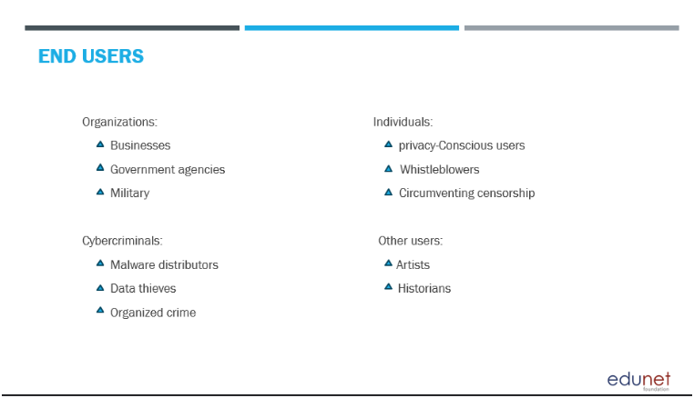
ORANIZATIONS :
CYBERCRIMINALS :
.
.
.
.
Businesses
Military
Government Agencies
Malware Distributors
Data Thieves
Organized Crime
.
.
INDIVIDUALS :
OTHER USERS :
.
.
.
.
Privacy Conscious Users
Whistleblowers
Circumventing Censorship
Artists
Historians
.

Slide 7

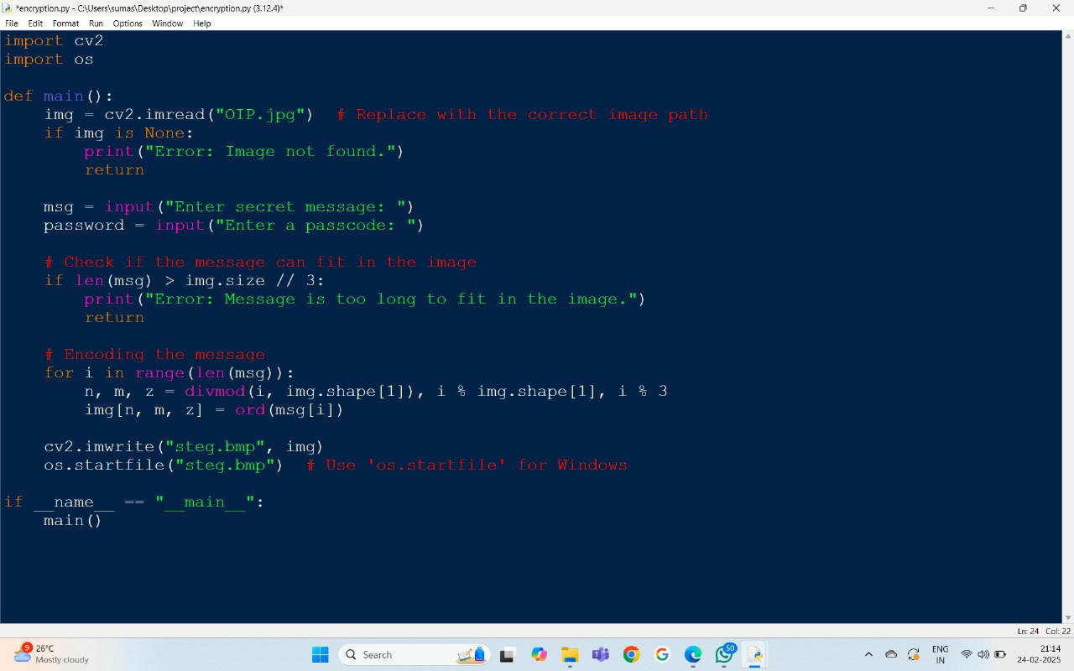
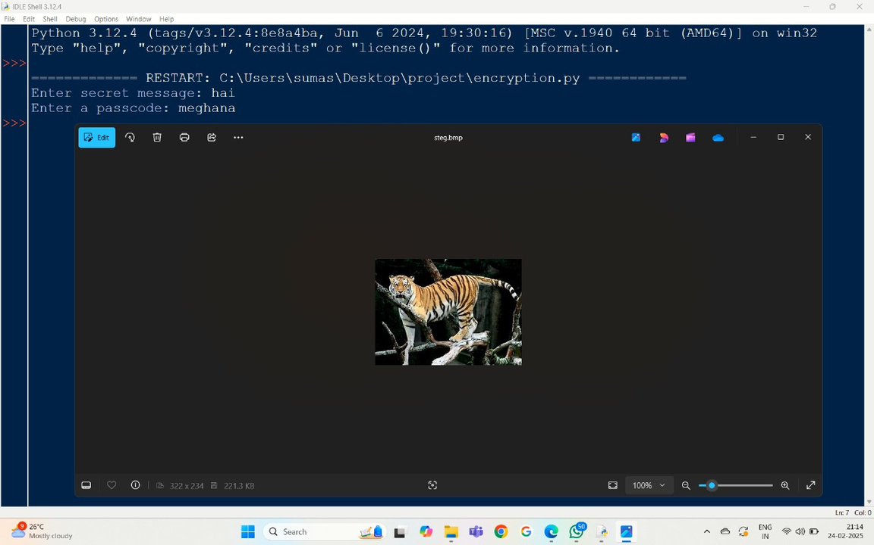
ENCRYPTION:

Slide 8
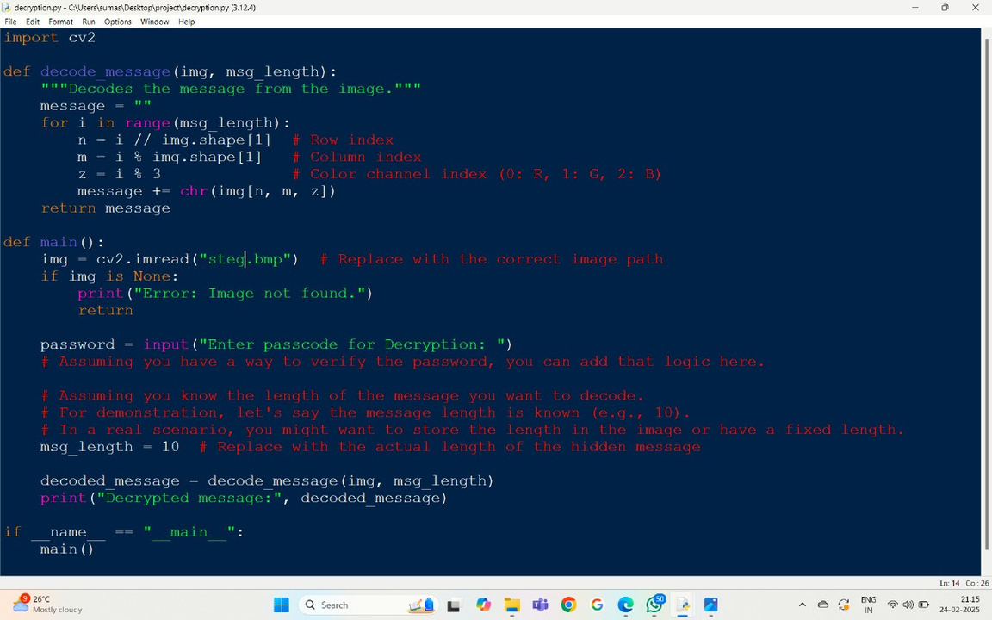
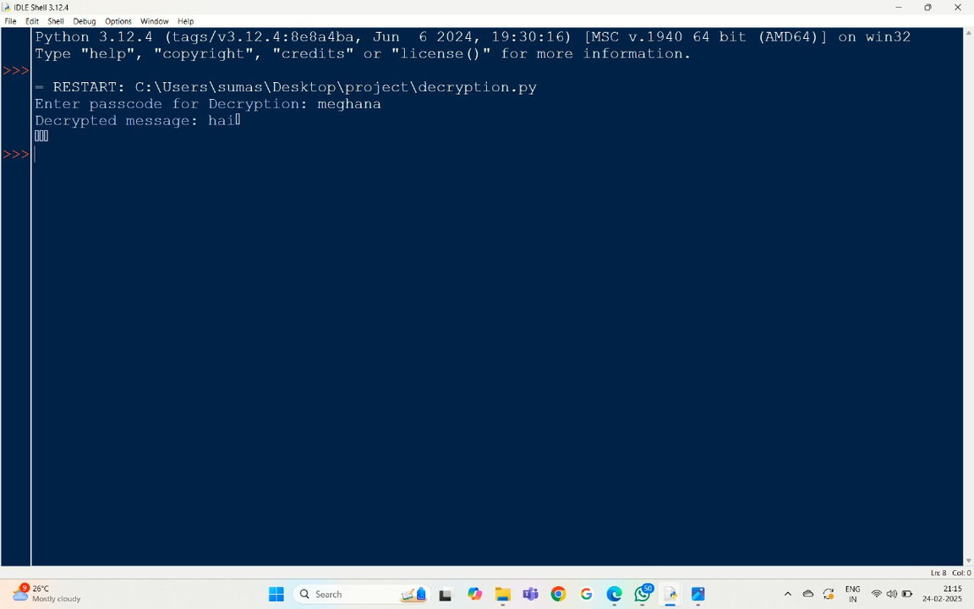
DECRYPTION:

Slide 9
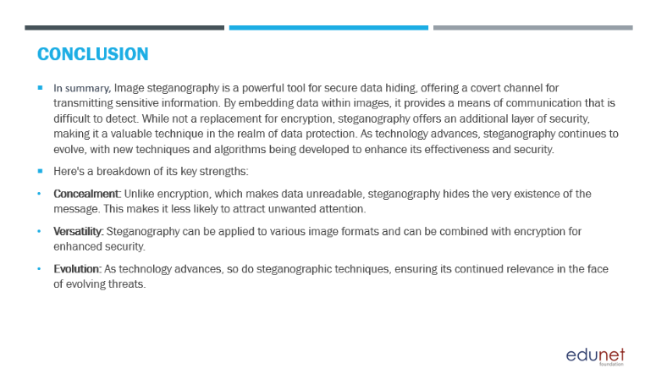
.
.
Summary of Image Steganography :
Image steganography is a technique for secure data hiding.
It embeds data in images, making detection difficult.
Serves as an additional layer of security, complementing encryption.
Continues to evolve with new techniques and algorithms.
Key Strengths:
Concealment: Unlike traditional encryption that makes data unreadable, steganography hides the existence of the message. Reduces the risk of attracting unwanted attention.
Versatility:Applicable to various image formats. Can be combined with encryption for enhanced security.
Evolution: Adapts to technological advancements. Techniques evolve to stay relevant against emerging threats.
.
.
.
.
.
.
.
.
.
.

Slide 10

https://github.com/Meghanakalle/AICTE

Slide 11


